Slide 1
Community Living Manitoulin

Slide 2
Strategic Plan 2022-2025

Slide 3
Creation of strategic plan
Understanding current state
Review reports, data and legislation plans
Identify organizational and system trends
Clarify mission, vision and values
Input from Stakeholders
Engagement through survey. Participants included Individuals and families, staff, board members, and partners
Plot a course forward
Reaffirm mission and vision
Identify areas of strength, growth, opportunity and risk
Create engagement strategy for all stakeholders

Slide 4
CLM Mission created in 2012 reaffirmed in 2022 CLM advocates for, promotes, and facilitates the full participation, inclusion, and citizenship of people who have a developmental disability
CLM Vision
Created in 2012 reaffirmed in 2022
CLM envisions a society where everyone belongs, has equality, respect and acceptance. This gives people a sense of self-worth and opportunities for growth. The gifts, uniqueness and innate value of each individual are celebrated, supported and acknowledged as essential to the completeness of the whole community

Slide 5
2022-2025 Strategic Directions
Increase quality of care through overall person-centred experience
Cultivate a culture of transparency and accountability
Improve community connection through increased access and integration for individuals
Upgrade internal systems and technology to enhance capabilities and innovation
Expand external partner relationships through engagement and collaboration

Slide 6
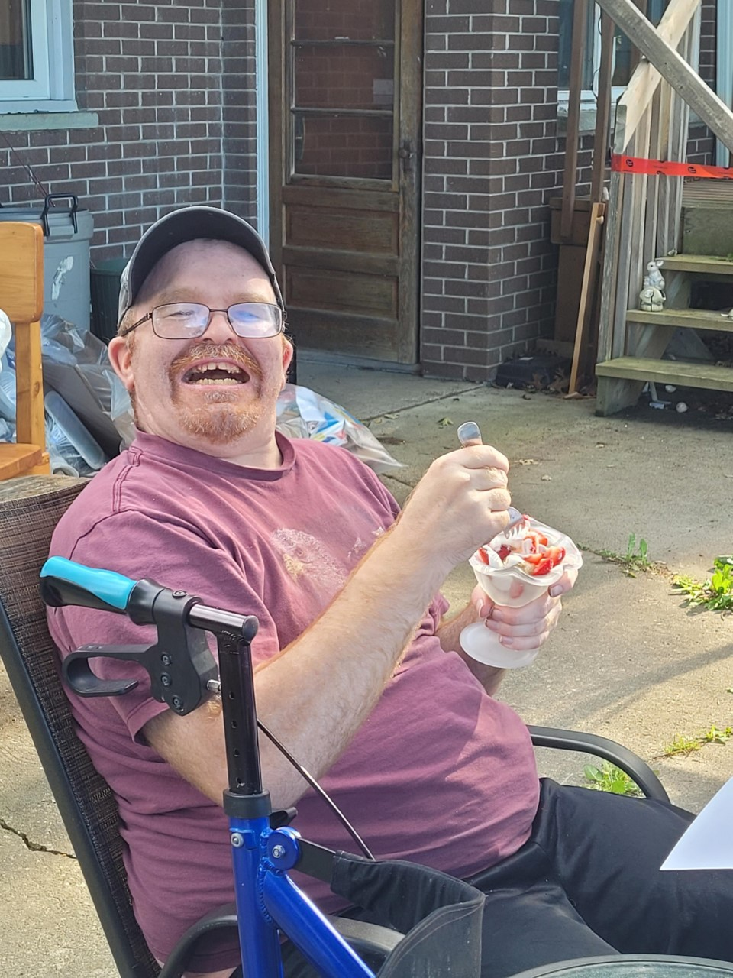
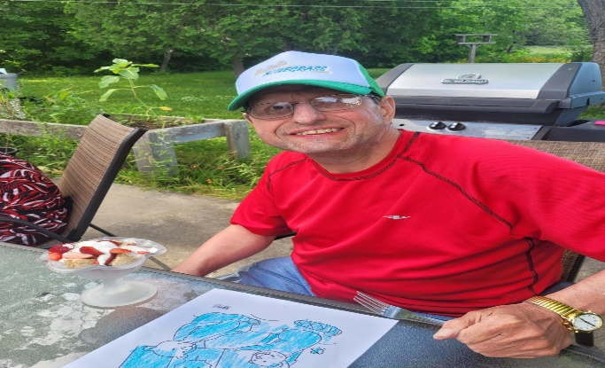
2022-2025 Strategic Goals
1. Increase quality of care through overall person-centred experience
provide opportunities for learning and growth in areas of individual interest
utilize passport funding to increase and enhance activities and outings that are individual specific
empower independence through individual goal clarity and SMART action planning to achieve these goals
utilize KPI’s/surveys to measure and monitor changes to level of quality of care

Slide 7
2022-2025 Strategic Goals continued
2. Cultivate a culture of transparency and accountability
Promote and sustain a culture of inclusivity
Provide opportunities for professional development and advancement
Introduce and implement Accountability Based Management
Strengthen union/employer relations
3. Improve community connection through increased access and integration for individuals
Reimagining community activities through the HUB
Provide opportunities for individualized education and training of interest for each individual
Participate in community functions
Pursue individual job/volunteer opportunities

Slide 8
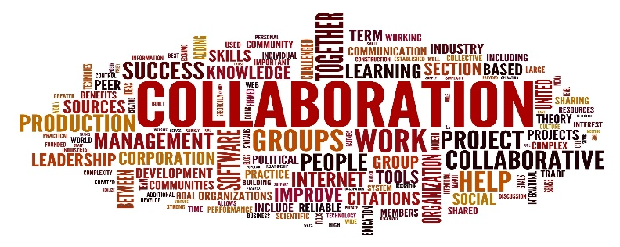
2022-2025 Strategic Goals continued
4. Upgrade internal systems and technology to enhance capabilities and innovation
Increase internet capabilities through alternative provider
Upgrade internal system to allow working remotely
Introduce and Implement systems to streamline scheduling, payroll and human resources
Revamp and maintain agency website
5. Expand external partner relationships through engagement and collaboration
Work with regional and provincial partners on opportunities of collaboration
Establish relationships with community partners to focus on innovative approaches to person-centred planning
Promote opportunities of cross learning and training to build a system of supports and resources

Slide 9
Keys to Success
Excellence in Execution
Strong Engagement
Reinforce Culture
Celebrate Achievements
Lead by Example
Ensure Rewards and Recognition
Integrate Strategy at all levels
Key Updates and Reporting
CLM Journey to Success
CLM will execute our new strategic plan ensuring the inclusion of all supported individuals, families, staff, board members and community partners. Empowering everyone at every level to achieve our common goals.

